Slide 1

Occluder’s Effect in NLOS Adam Bricha
Chau Nguyen German Becerra Tovar
Keval Kataria
Quang Vu
4/24/2024

Slide 2
The Problem
Non Line of Sight imaging has many potential applications
Self Driving Cars
Medical Imaging
Search and Rescue
Typically, these systems use active methods to image the scene
This paper attempts to use a passive method using far less expensive technology

Slide 3
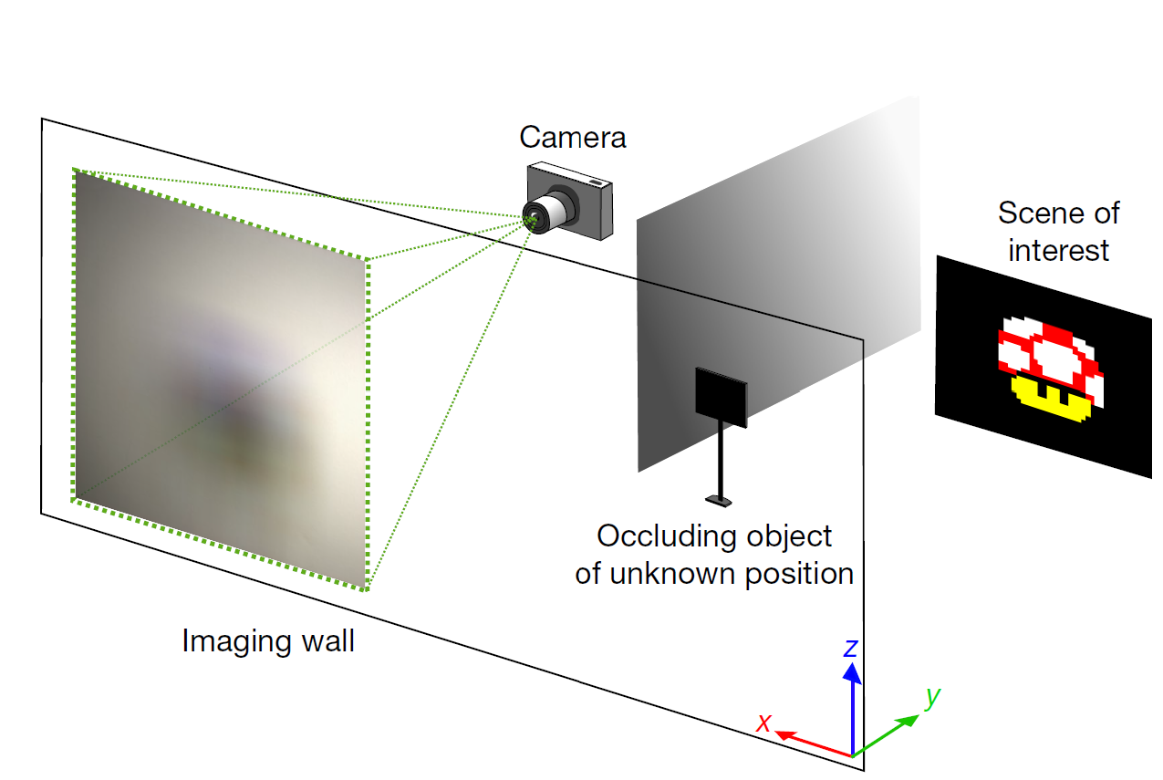
The Environment

Slide 4
Hardware Setup
Digital Camera:
High-resolution, tripod-mounted for stability.
Manual adjustments for exposure, focus, ISO.
Occluder:
Flat board blocking direct line of sight.
Adjustable position and orientation.
Hidden Scene:
Objects placed out of direct view.
Variable configurations for complexity testing.
Light Source:
Ensures adequate scene illumination.
Positioned to avoid direct camera exposure.
Computational Resources:
Computer with MATLAB for control and processing.
Simulates real-world noise conditions.

Slide 5
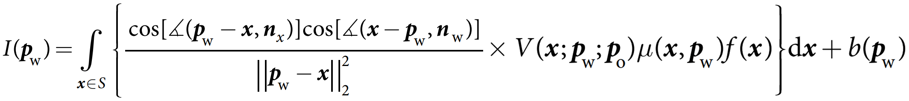
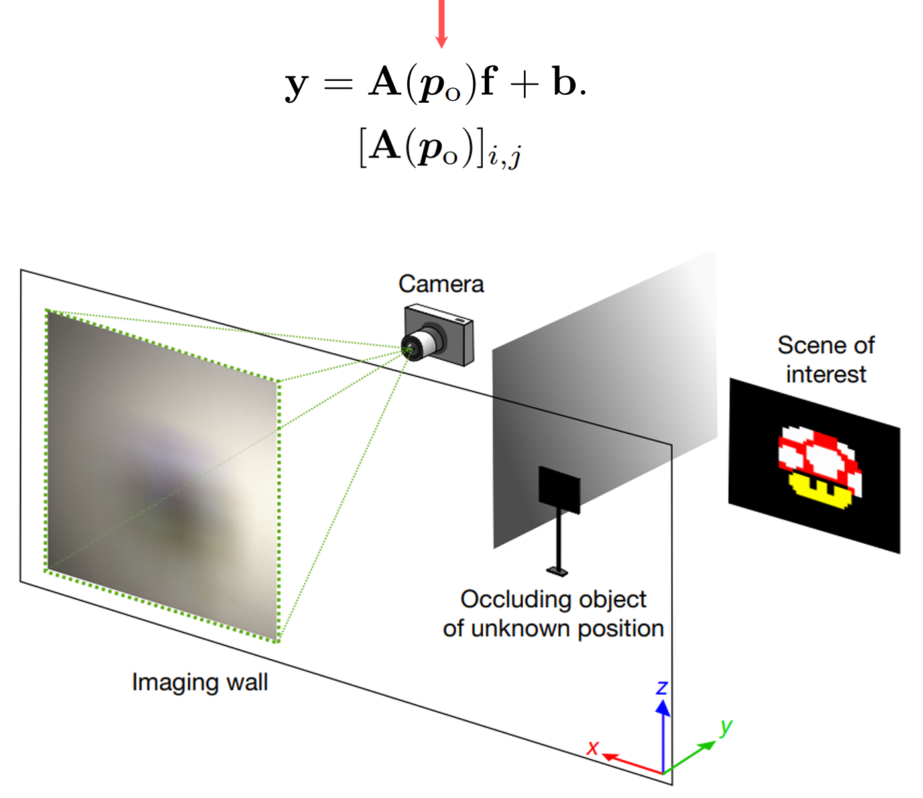
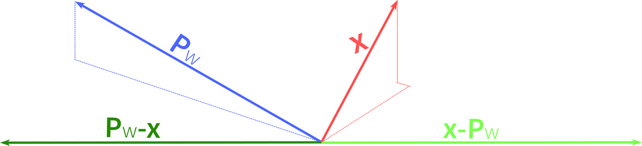
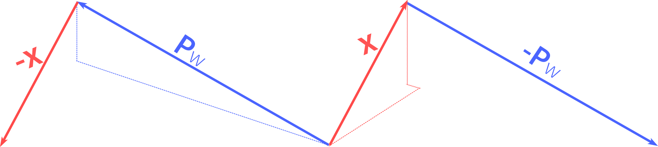
Forward Model/Problem

Slide 6

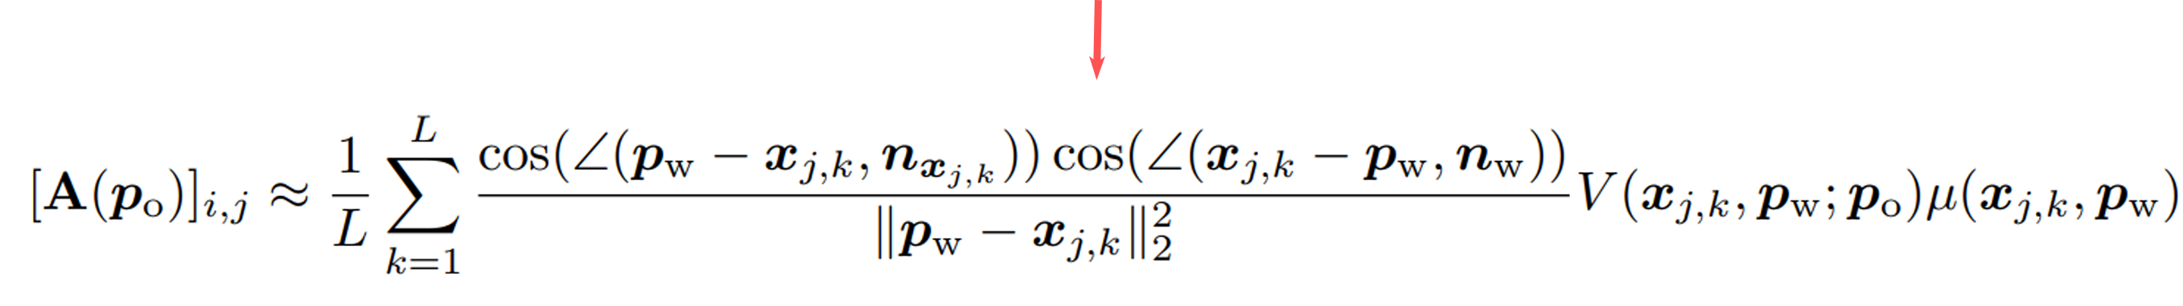
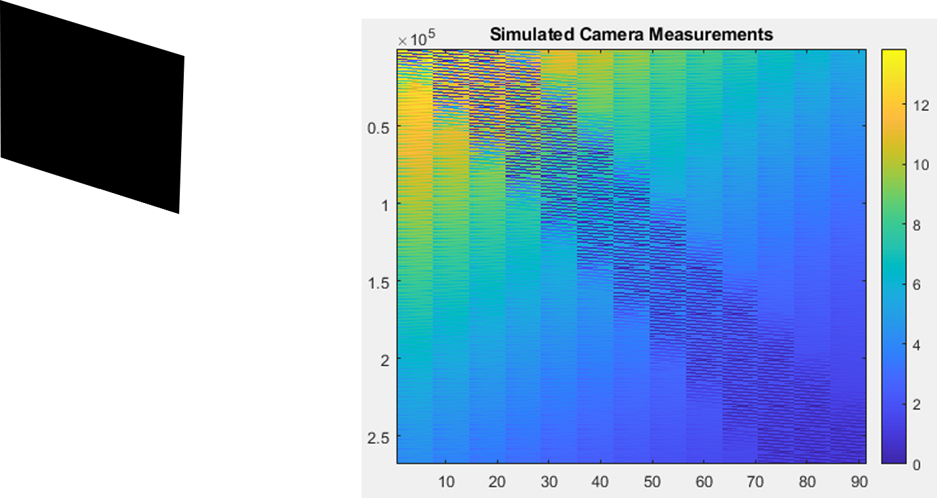
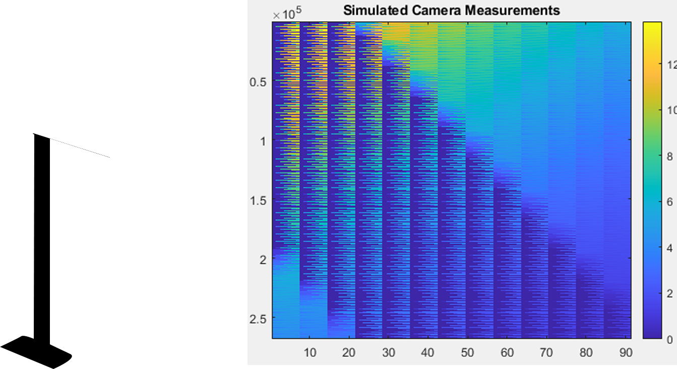
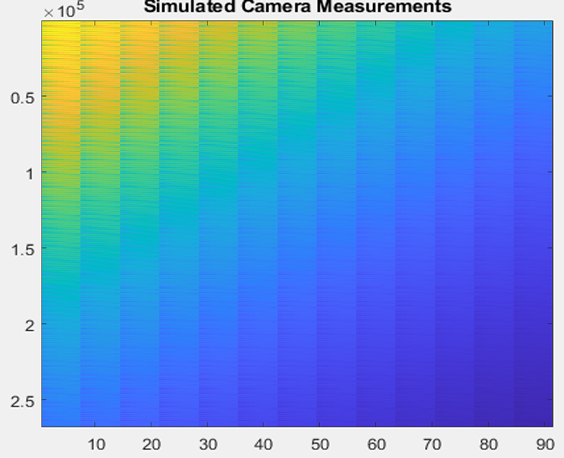
Occluder?

Slide 7
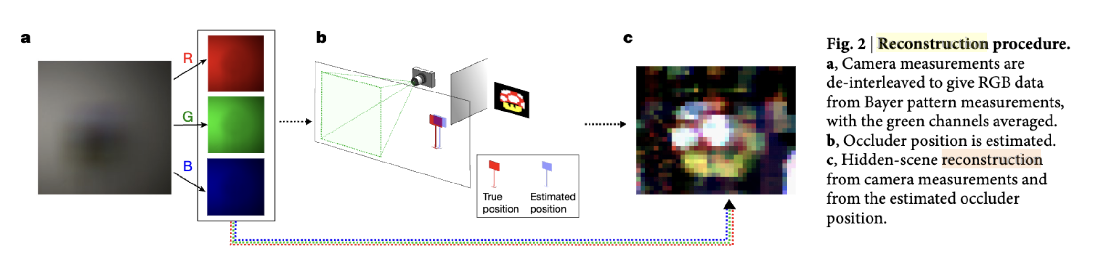
Inverse Model/Problem
Goal: Estimate the occluder position $\hat{p_{0}}$ using camera measurements $y$, which is used to estimate the hidden scene of interest $\hat{f}$.
Notes:
In the inverse problem, our goal is to recover both the position of the occluder p0 and the hidden scene of interest f from the single-snapshot camera measurement y in one color channel.
To reconstruct the hidden scene, we will use the raw data captured by the camera sensor to reconstruct a full-color RGB image. With these camera measurements, we then estimate the position of the occluder, which can be used to estimate the RGB content of the hidden scene of interest.

Slide 8
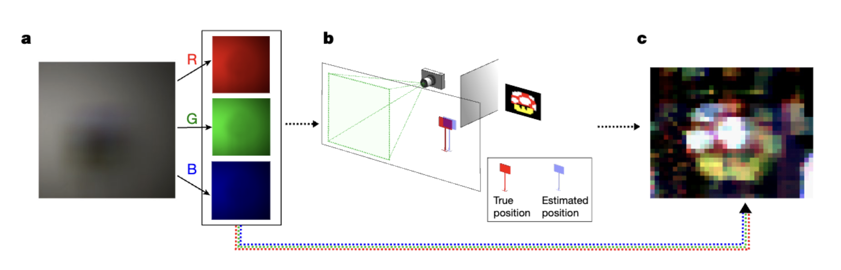
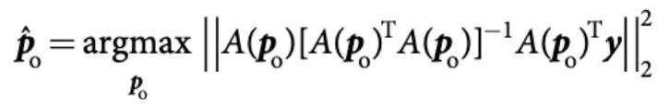
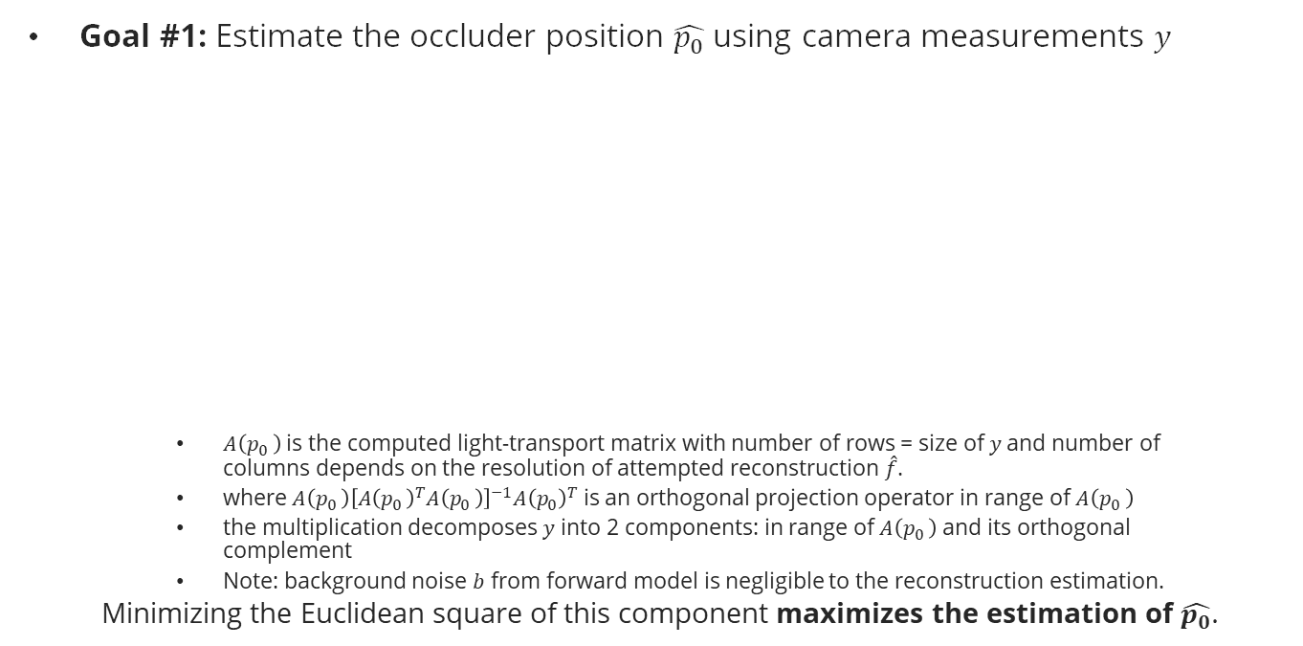
Inverse Model/Problem Part 1
Goal #1: Estimate the occluder position $\hat{p_{0}}$ using camera measurements $y$
$A\left(p_{0 }\right)$ is the computed light-transport matrix with number of rows = size of $y$and number of columns depends on the resolution of attempted reconstruction $\hat{f}$.
where$A\left(p_{0 }\right){\left[{A\left(p_{0 }\right)}^{T}A\left(p_{0 }\right)\right]}^{−1}{A\left(p_{0}\right)}^{T}$ is an orthogonal projection operator in range of $A\left(p_{0 }\right)$
the multiplication decomposes $y$ into 2 components: in range of $A\left(p_{0 }\right)$ and its orthogonal complement
Note: background noise $b$ from forward model is negligible to the reconstruction estimation.
Minimizing the Euclidean square of this component maximizes the estimation of $\hat{p_{0}}$.
Notes:
where A(p­0) is the computed light-transport matrix for an occluder position p0.
is an orthogonal projection operator onto the range A(p0). The multiplication of this component and y decomposes y into a component in range A(p0) and a component in the orthogonal complement, which represents the amount of model mismatch using the current occluder position.
Minimizing the Euclidean square of this component is solving for the maximization problem in the above equation, which maximizes the likelihood estimate of p0.
Argmax over p0­­ means that we are estimating the occluder position for each color channel (i.e., R, G, B) and take the average to find the best estimate of p0.
From the forward model defined by for each color channel, it is possible to omit the background component of the camera measurement. This is because the background can be decomposed into 3 components, b = b0 + b1 + b2, where b0 locates within the computational FOV, b1 locates near the computational FOV, and b2 locates far from the computational FOV. Only b0 lies in the range of A(p0) and the visibility function is independent of b­2, therefore the degradation in estimating p0 is primarily influenced by b1. However, this influence is considered negligible when omitting the background components altogether.

Slide 9
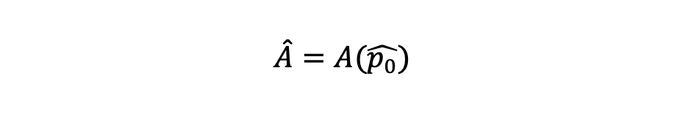
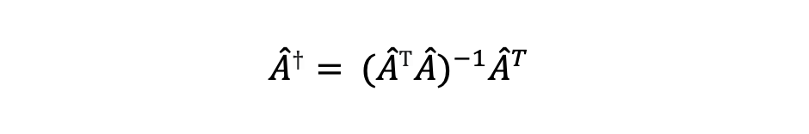
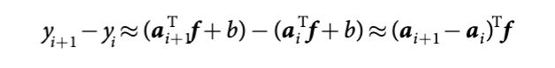
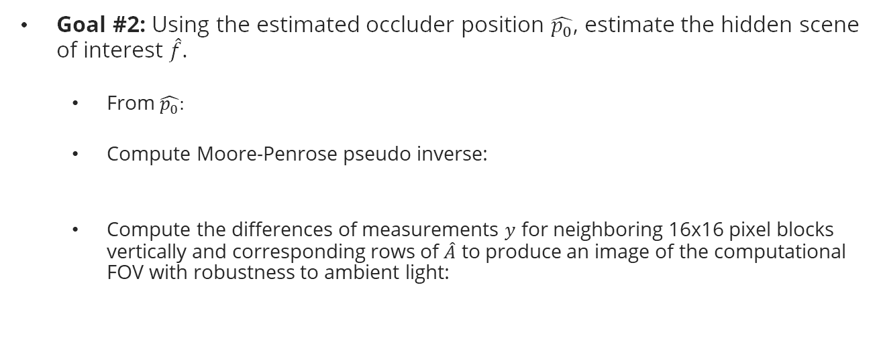
Inverse Model/Problem Part 2
Goal #2: Using the estimated occluder position $\hat{p_{0}}$, estimate the hidden scene of interest $\hat{f}$.
From $\hat{p_{0}}:$
Compute Moore-Penrose pseudo inverse:
Compute the differences of measurements $y$ for neighboring 16x16 pixel blocks vertically and corresponding rows of $\hat{A}$ to produce an image of the computational FOV with robustness to ambient light:
Notes:
From the estimated occluder position, we can estimate the light-transport matrix .
Using Moore-Penrose pseudo inverse formula, we can find the pseudo inverse of the light-transport matrix .
In ideal conditions where the estimated occluder position is the exact location p0 and the model mismatch and background influence are negligible, then multiplying the camera measurements y in each color channel by the Moore-Penrose pseudo inverse yields the least-squares estimate of the hidden scene’s color pixel values.
However, to improve the inverse model’s robustness to noise and model mismatch, we can exploit the transverse spatial correlations that are dominant in real-world conditions. This is achieved by promoting sparsity in the scene’s gradient using total variation regularization:

Slide 10
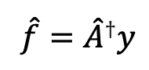
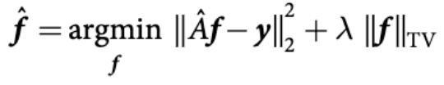
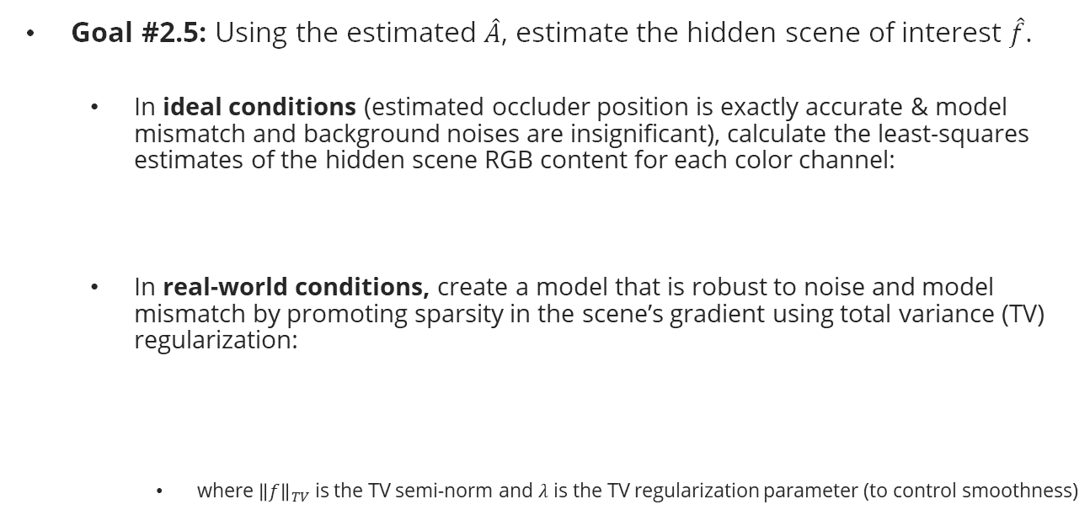
Inverse Model/Problem Part 2
Goal #2.5: Using the estimated $\hat{A}$, estimate the hidden scene of interest $\hat{f}$.
In ideal conditions (estimated occluder position is exactly accurate & model mismatch and background noises are insignificant), calculate the least-squares estimates of the hidden scene RGB content for each color channel:
In real-world conditions, create a model that is robust to noise and model mismatch by promoting sparsity in the scene’s gradient using total variance (TV) regularization:
where ${\left\|f\right\|}_{TV}$ is the TV semi-norm and $λ$ is the TV regularization parameter (to control smoothness)
Notes:
From the estimated occluder position, we can estimate the light-transport matrix .
Using Moore-Penrose pseudo inverse formula, we can find the pseudo inverse of the light-transport matrix .
In ideal conditions where the estimated occluder position is the exact location p0 and the model mismatch and background influence are negligible, then multiplying the camera measurements y in each color channel by the Moore-Penrose pseudo inverse yields the least-squares estimate of the hidden scene’s color pixel values.
However, to improve the inverse model’s robustness to noise and model mismatch, we can exploit the transverse spatial correlations that are dominant in real-world conditions. This is achieved by promoting sparsity in the scene’s gradient using total variation regularization:

Slide 11
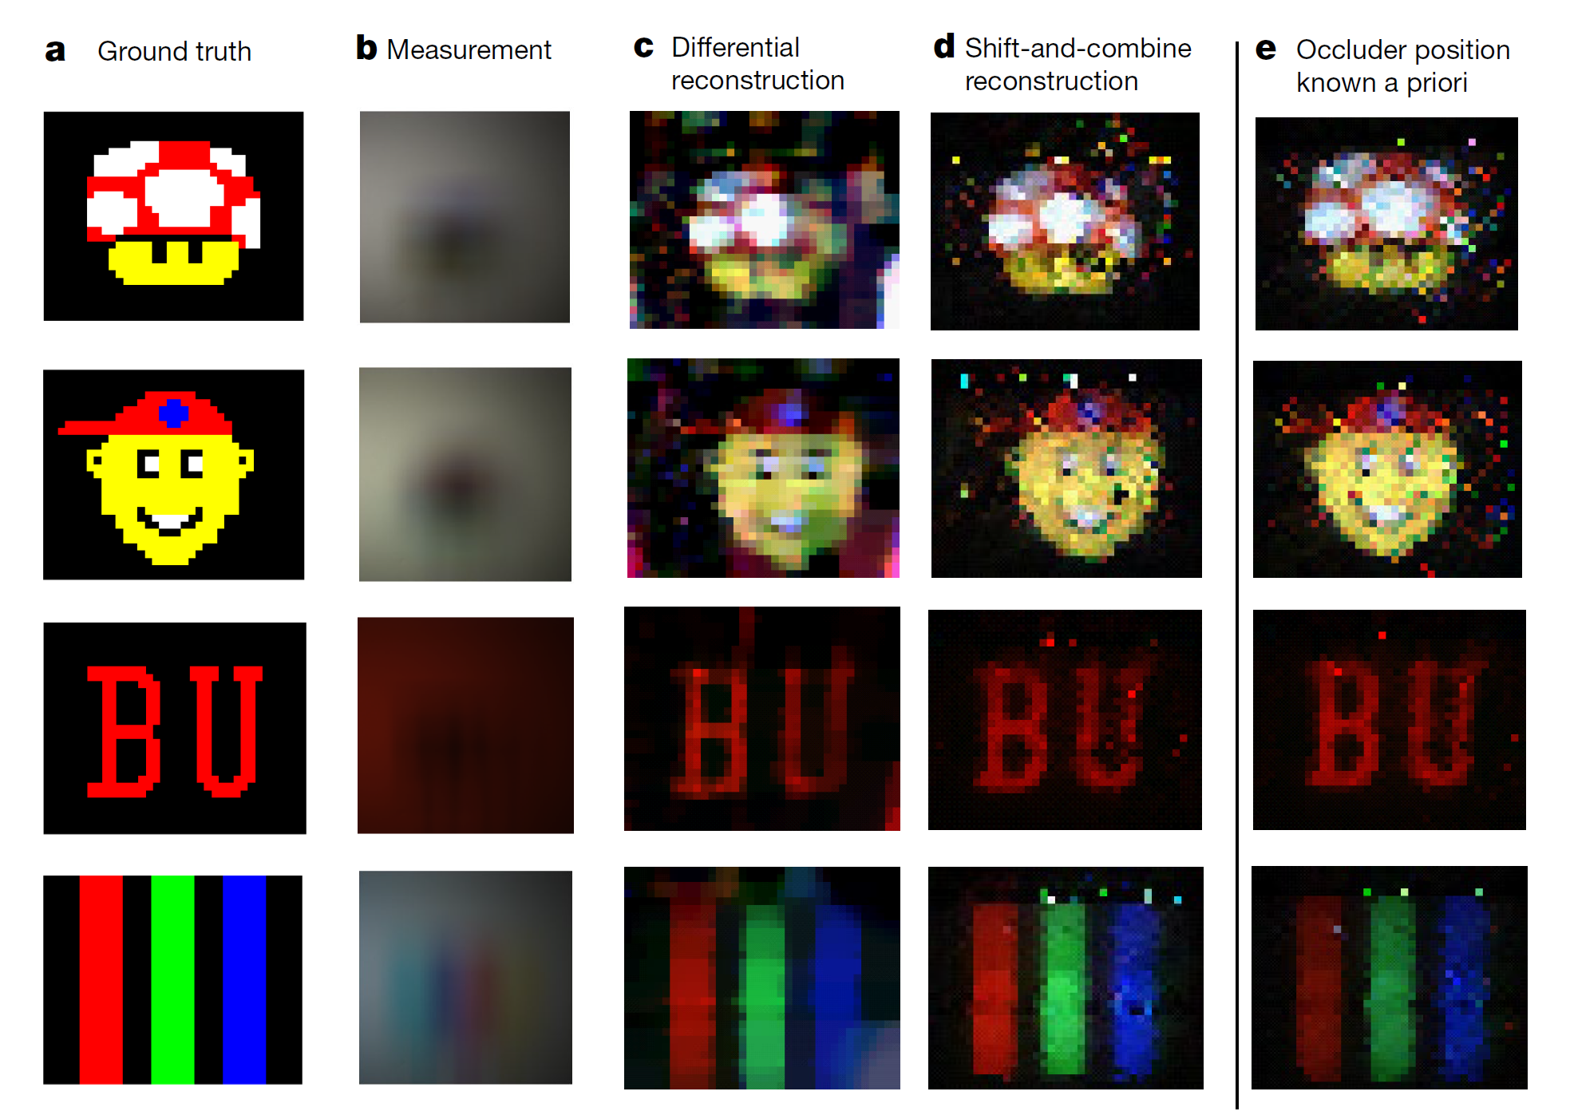
Results

Slide 12
Our Findings
We made 2 changes to the code provided
First, we added noise to the simulated measurements
Second, we tested different occluder positions

Slide 13
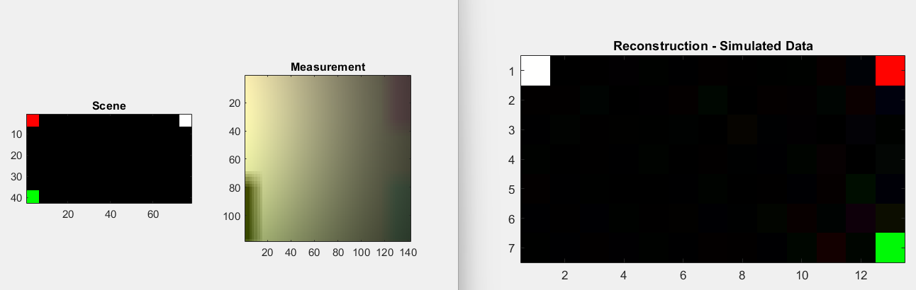
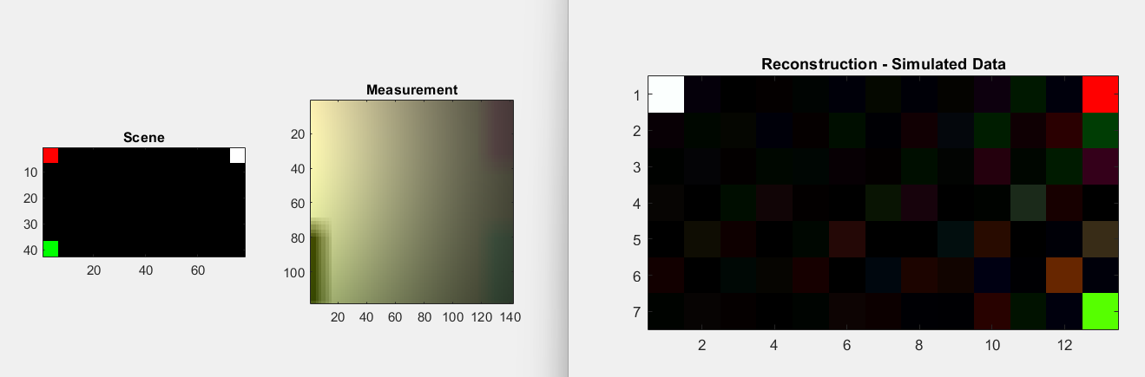
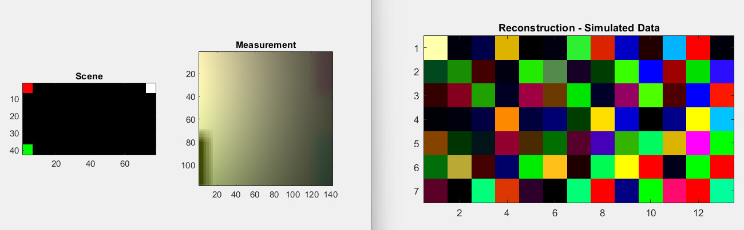
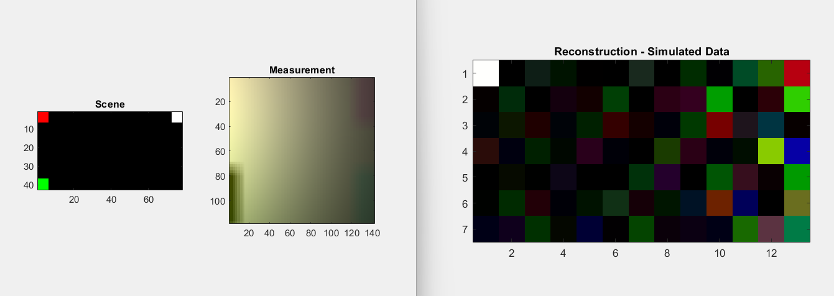
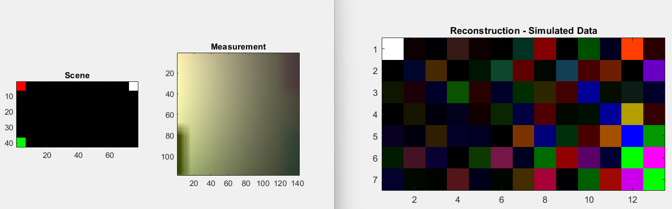
Our Findings
SNR 0-40
SNR = 15
SNR = 25
SNR = 0
SNR = 10
SNR = 40

Slide 14
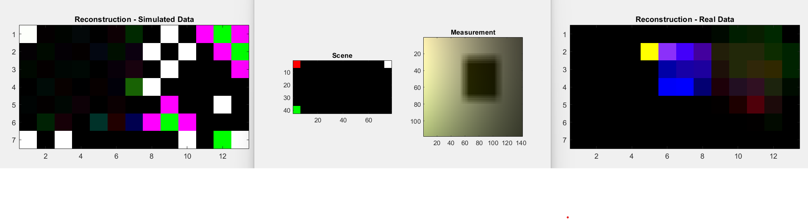
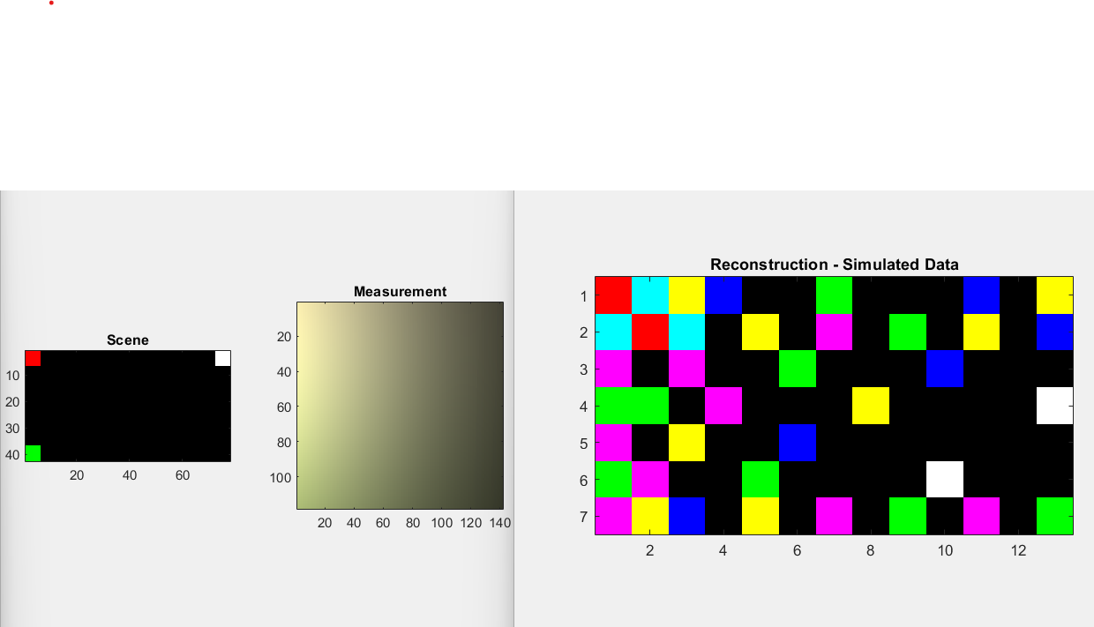
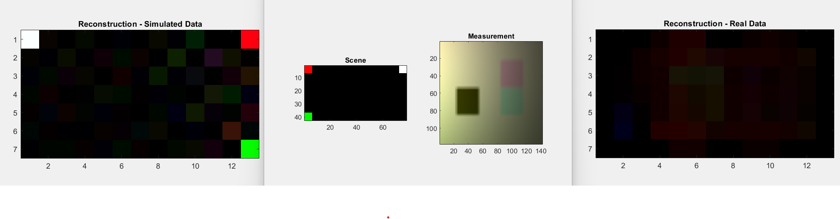
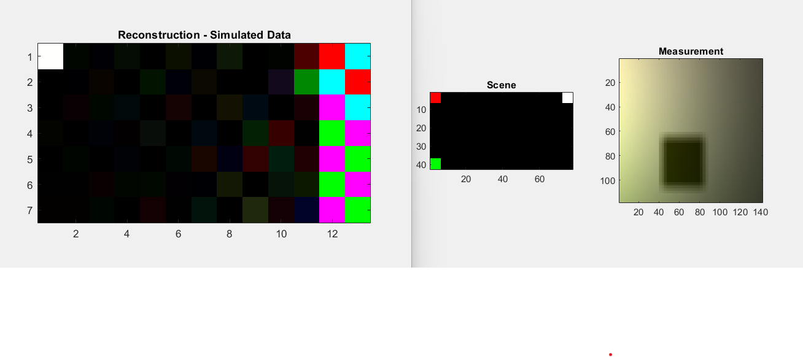
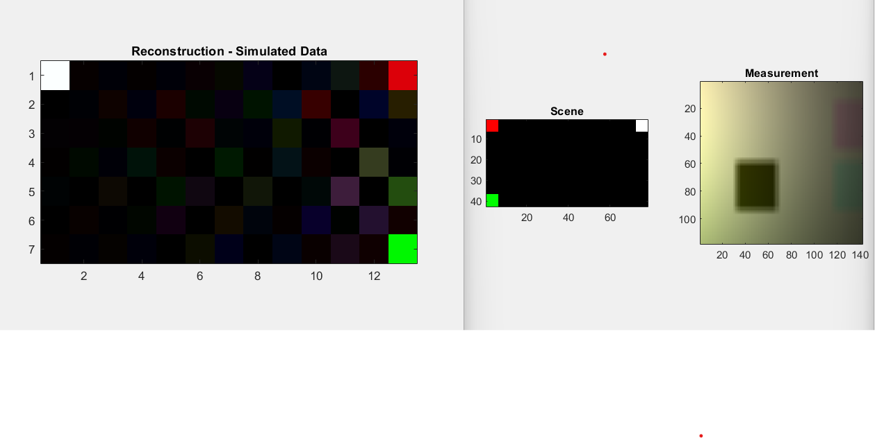
Our Findings

Slide 15
Conclusion
Difficulties:
Changing the shape and number of occluders makes reconstruction result volatile
Need for generalization/improvement:
What can be done to stabilize the reconstruction result when the shape and number of occluders vary, especially in real-life situations?

Slide 16
Conclusion
This paper attempts to use passive methods to perform Non-Line-of-Sight Imaging
We make the problem less ill-conditioned by adding the occluder
By using methods to reduce noise and testing different occluders and positions we can improve the reconstruction

Slide 17
Future Work
Making these methods more applicable to other environments without precise tuning of occluders and locations.
Increasing Computational power so this can be applied more effectively
Non-matlab implementation

Slide 18
Questions?
Thank you for your time

